Slide 1
Basic Linear Regression
Richard A. Reitmeyer
August 2016
Copyright 2016 R. A. Reitmeyer. Released under Creative Commons CC-BY 4.0 license.

Slide 2
Objectives
Participants should be able to:
  Create a basic linear regression in R
  Compare models
  Evolve simple models into more sophisticated ones by hand
  Explain the basic linear algebra behind linear regression

Slide 3
Topics
“Doing” data science
Linear models
Linear algebra
Model matrix
Titanic, in gory detail

Slide 4

Why is it called data “science”
Our goal is data “science”
Extract knowledge or inference from data
  Easier than ever: Computers + Data
Want to be able to predict things
  Or classify things
  Or infer cause (A/B testing)
Goal: a model that lets us predict a response from features

Slide 5
“Doing” Data Science, simplified
Start with a question
Look at the data
Build a simple model, with a simple modeling technique
Extend the model

Slide 6
“Doing” Data Science, simplified
These slides talk about
one modeling technique and
will only touch on other topics
Start with a question
Look at the data
Build a simple model, with a simple modeling technique
Extend the model

Slide 7
Linear (Least Squares) Regression
THE classic technique of data analysis
  Used by Gauss around 1800 to predict Ceres' orbit
  May go back a bit further to Legendre
  Proven “optimal” by Gauss in early 1820s
Requirements
  Errors are Independent and Identically Distributed (IID)
    Errors have zero mean
    Errors are “homoscedastic” – independent of the value of prediction terms
  Errors are normally distributed
Assumption: prediction terms are known exactly

Slide 8
Sample Problems
Titanic: predict who lived / died
  Given training data of ~700 passengers, predict survival of another ~200
Property Values
School Performance

Slide 9
Theory
All “science” starts with a question, and a theory about that question
Your plausible theory could be implausible to me:
  Men are stronger and better swimmers, so men have better odds than women
  Edwardian era notions of stoic manliness and women's need of protection mean special treatment for women, so women have better odds
  Women have more body fat, and so should survive better in cold water
Data can eliminate testable theories that are “bad”

Slide 10
How confident?
Before acting on a prediction, want to be know how confident we should be in it
  How strongly should we act on the prediction?
Use statistics to estimate likelihood
  95% likely: Academic, small sample benchmark
  99% likely, 99.9% likely: larger data sets, more need for certainty
Won't cover model validation tonight, but it's an important topic

Slide 11
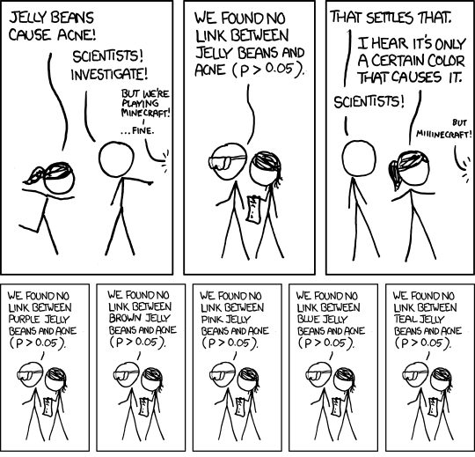
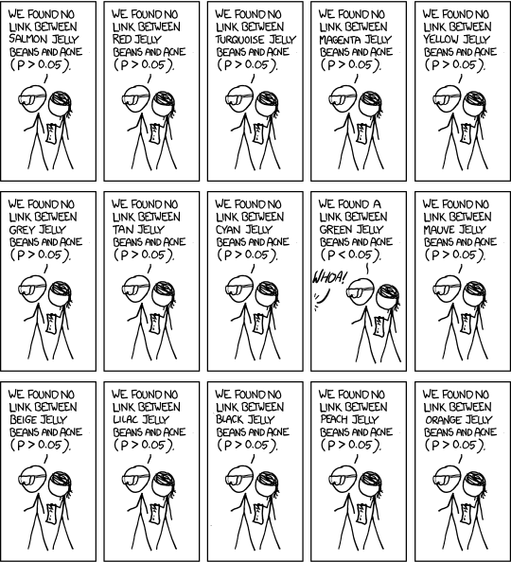
95% Confidence
https://xkcd.com/882/

Slide 12
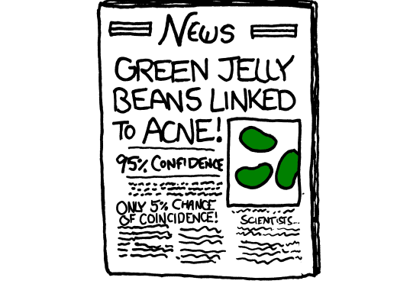
95% Confidence
https://xkcd.com/882/

Slide 13
Linear Models
A linear model is one where the response is related to the predictors in strictly additive way
  Remember algebraic geometry: y = m*x + b?
Linear model is y = b0 + b1*x1 + b2*x2 +…+ bn*xn + e
  y is response, the thing to predict
  x is a predictor term, a known feature or something derived from a feature (or features)
  b is a coefficient
  e is error --- must be gaussian, IID!

Slide 14
Simple or Complex
Linear models can be almost as simple or complex as you like:
  Dinner_bill = baseline_taxi_fare + avg_food_cost*diners + avg_beer_cost*drinkers
  Mpg = baseline + b1*(1/weight)+b2*(1/weight^2) + b3*(1/horsepower)
  Home_price = baseline + b1*sqft + b2*neighborhood + b3*sqft:neighborhood
Counterexample:
  mpg = baseline + (1/hp)^b1
There are also extensions to linear models (“generalized”) to handle some non-gaussian distributions, used for classification, but we'll ignore those in this talk.

Slide 15
Three Minutes of Linear Algebra
Way to write, work with, and solve large number of large linear equations
4 * b1 | + | 3 * b2 | + | 5 * b3 | + | 1 * b4
9 * b1 | + | 1 * b2 | + | 3 * b3 | + | 6 * b4
2 * b1 | + | 2 * b2 | + | 2 * b3 | + | 2 * b4
7 * b1 | + | 7 * b2 | + | 1 * b3 | + | 1 * b4
15
12
20
34
=
4 | 3 | 5 | 1
9 | 1 | 3 | 6
2 | 2 | 2 | 2
7 | 7 | 1 | 1
b1
b2
b3
b4
15
12
20
34
=
X b = y

Slide 16
Three Minutes of Linear Algebra
Addition: S = A + B, element Sij is Aij + Bij
Multiplication: P = A B, Pij is sum over all m of Aim * Bmj. Note A B != B A (not commutative)!
There is a “transpose” operation, written A' or x', that swaps rows and columns:
'
4 | 3 | 5 | 1
9 | 1 | 3 | 6
2 | 2 | 2 | 2
7 | 7 | 1 | 1
4 | 9 | 2 | 7
3 | 1 | 2 | 7
5 | 3 | 2 | 1
1 | 6 | 2 | 1
=
=
x1
x2
x3
x4
'
=
x1 | x2 | x3 | x4

Slide 17
Three Minutes of Linear Algebra
Identity matrix: has 1s on the top-left/bottom right diagonal and zeros elsewhere
  When anything is multiplied by identity, either side, get same matrix
“Inverse” operation: defined as producing the matrix such that multiplying a matrix by its inverse (on either side) yields the identity matrix.
  Similar to how the ordinary algebraic multiplicative inverse of n is 1/n, so 1/n*n = 1 and n*1/n = 1
  Only square matrix can have inverse
  Even square matrix can sometimes have no inverse (“ill-conditioned”), but “most” do have one

Slide 18
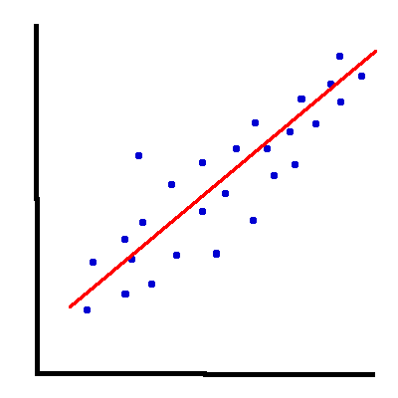
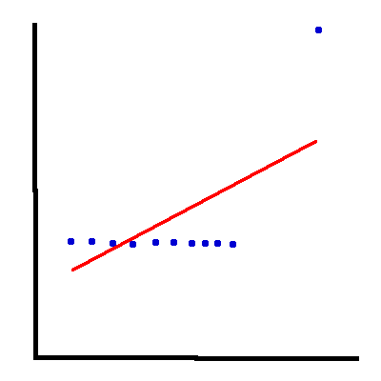
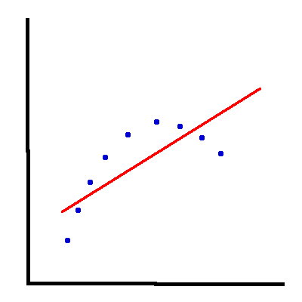
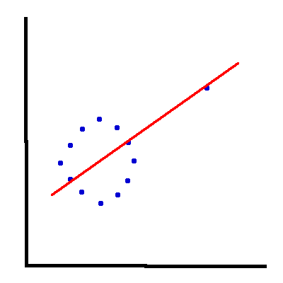
What is a Linear Fit?

Slide 19
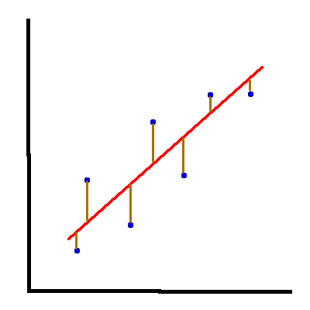
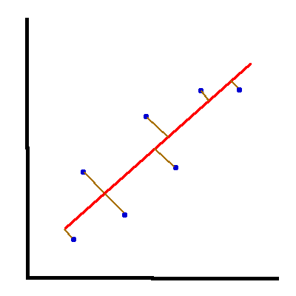
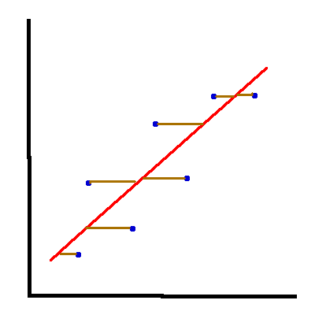
Reminder: What is Minimized?
residuals: actual – predicted
errors: predicted - actual

Slide 20
Quality Metrics
Many measures for “goodness” of a model
  Might be a good topic for a lecture of its own
Some important ones:
name | range | meaning
R^2 | 0..1 | Explained variance, 0=bad, 1=perfect, so models with bigger R^2 better.
P | > 0 | Probability model (or coefficient) is worthless, so models (coefficients) with smaller P better
confidence interval | N/A | Coefficient is likely to fall in this range
AIC/BIC | > 0 | “Information loss” when comparing models, smaller better

